Slide 1
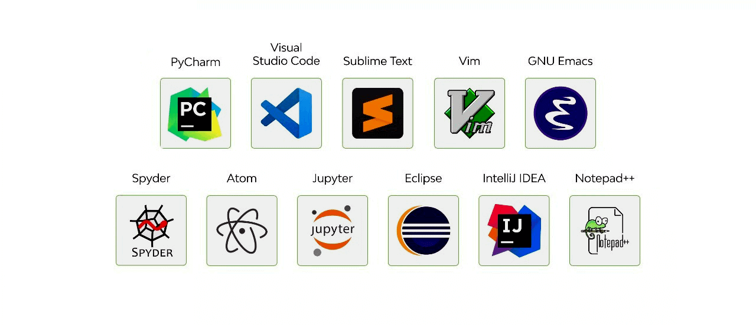
integrated development environments(ide) Momin asif, omar essa, Leila lewis

Slide 2
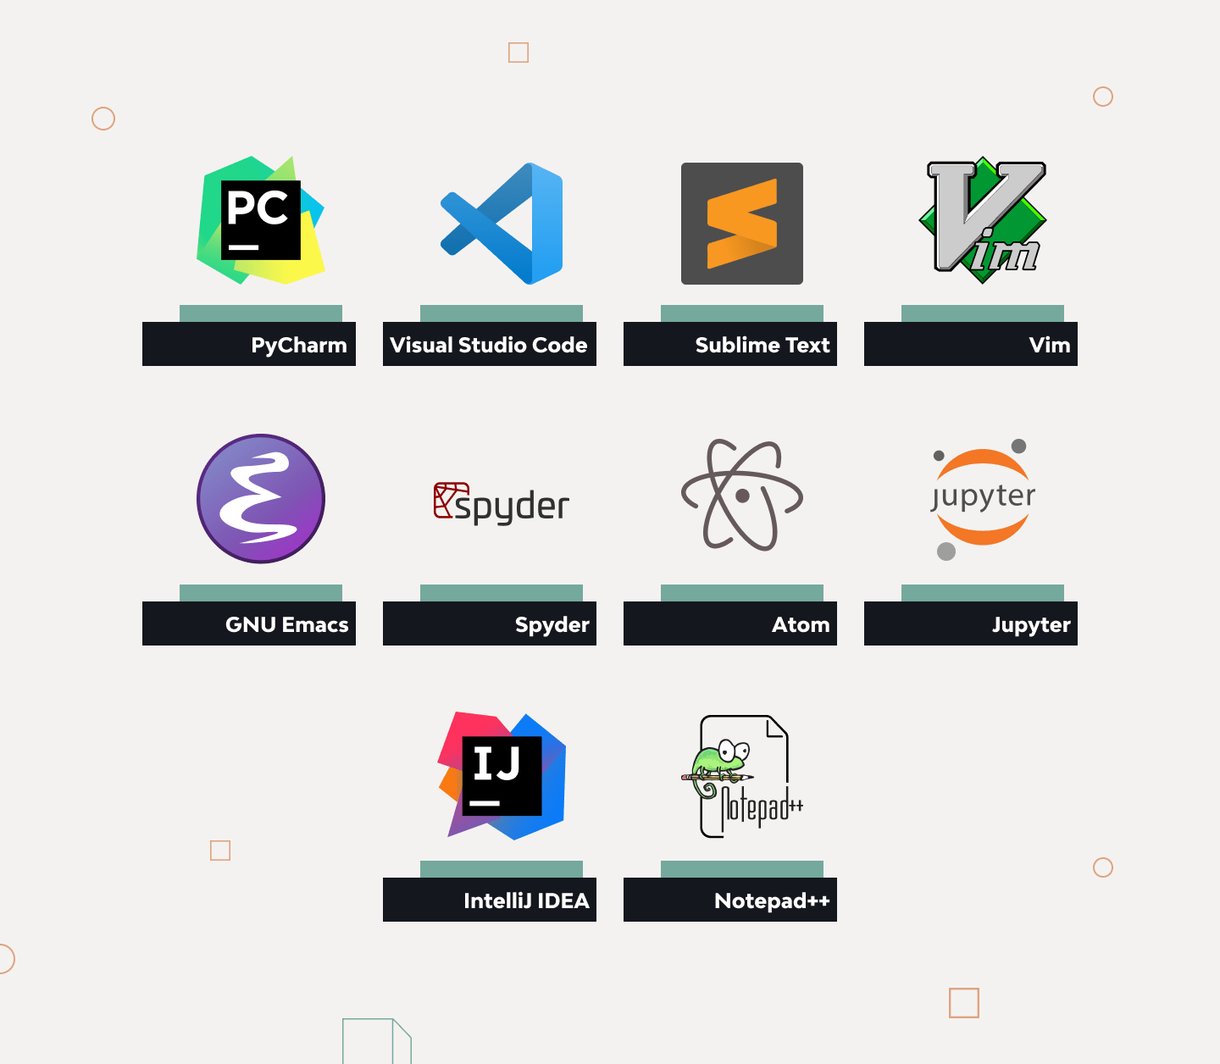
agenda
What are IDEs
What is Visual Studio Code
Tutorial
Extra Features
Why use Visual Studio

Slide 3
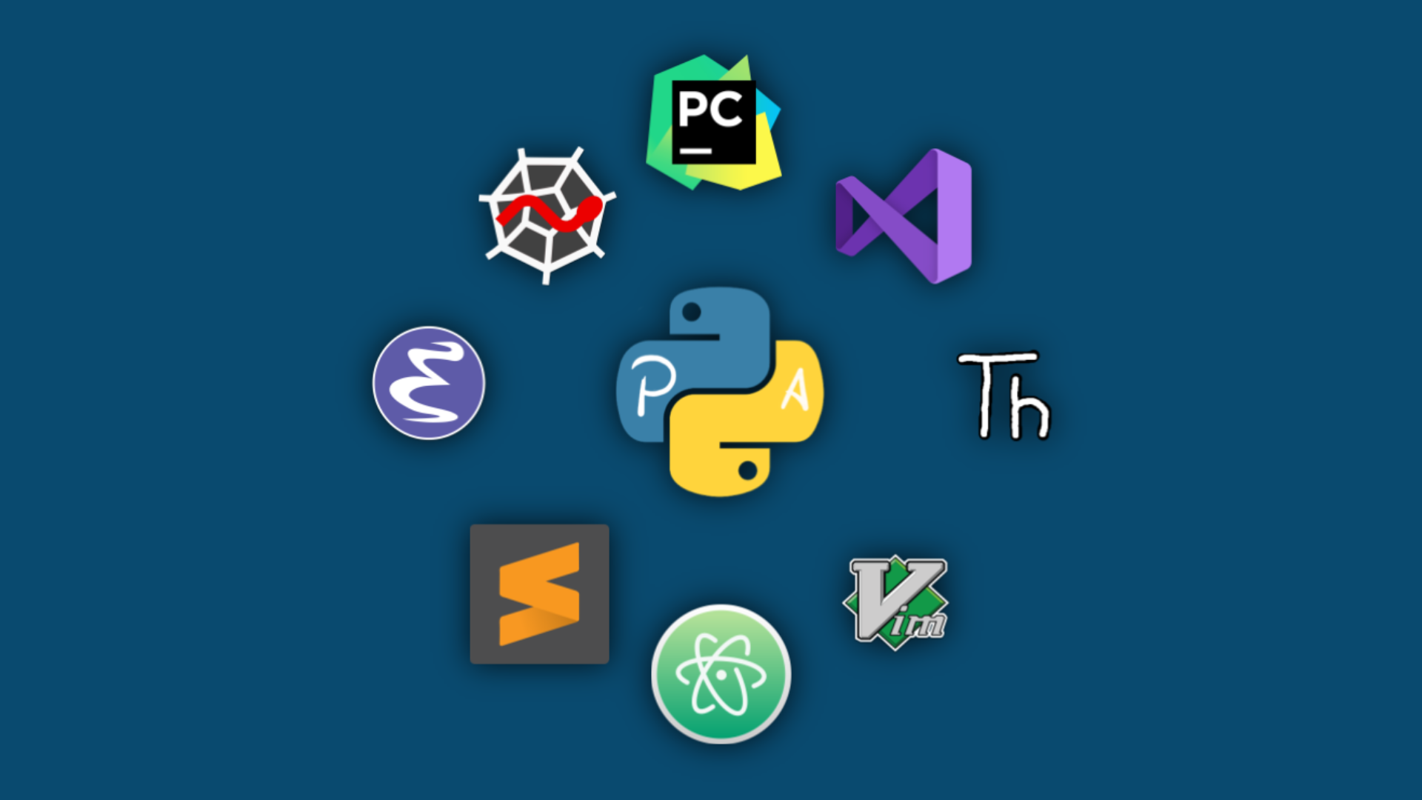
What is an IDE?
An IDE (Integrated Development Environment) is a software application that provides comprehensive tools for software development. It typically includes:
Code Editor: A text editor with features for writing and editing code, such as syntax highlighting and code completion.
Compiler/Interpreter: Tools to convert code into a machine-readable format or run scripts directly.
Debugger: A tool to test and debug code by running it step-by-step, allowing developers to inspect variables and control flow.
Build Automation Tools: Features to automate tasks like compiling code, running tests, and packaging applications.
Version Control Integration: Tools to manage code versions using systems like Git.
Examples of popular IDEs include Visual Studio, PyCharm, and Eclipse. They help streamline the coding process by integrating all the tools a developer needs into a single application.

Slide 4
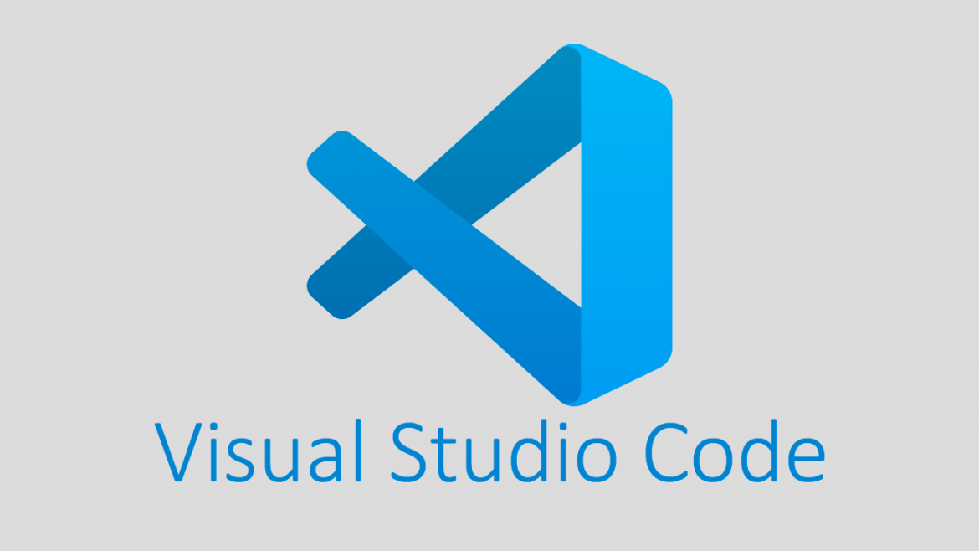
What is Visual studio code?
Visual Studio Code (often referred to as VS Code) is a free, open-source code editor developed by Microsoft. It is highly popular among developers due to its lightweight nature and extensive features, making it a versatile tool for a wide range of programming languages and development tasks.
Key features of Visual Studio Code include:
Code Editor: VS Code offers a robust code editor with features like syntax highlighting, code completion, and intelligent code suggestions (IntelliSense).
Extensions: VS Code has a rich ecosystem of extensions available through its marketplace, allowing developers to add support for additional languages, frameworks, tools, and functionalities.
Integrated Terminal: Developers can run command-line tools directly within VS Code, eliminating the need to switch between the editor and a separate terminal window.
Version Control: VS Code has built-in support for Git, making it easy to manage source control and collaborate with other developers.
Debugger: The editor provides debugging tools that allow developers to set breakpoints, inspect variables, and step through code execution.
Cross-Platform: VS Code is available for Windows, macOS, and Linux, making it accessible to a wide range of developers.
Customizability: Users can customize the editor's appearance, keyboard shortcuts, and behaviors to fit their workflow.
Overall, Visual Studio Code is highly regarded for its speed, flexibility, and ease of use, making it a popular choice for both beginners and experienced developers.

Slide 5
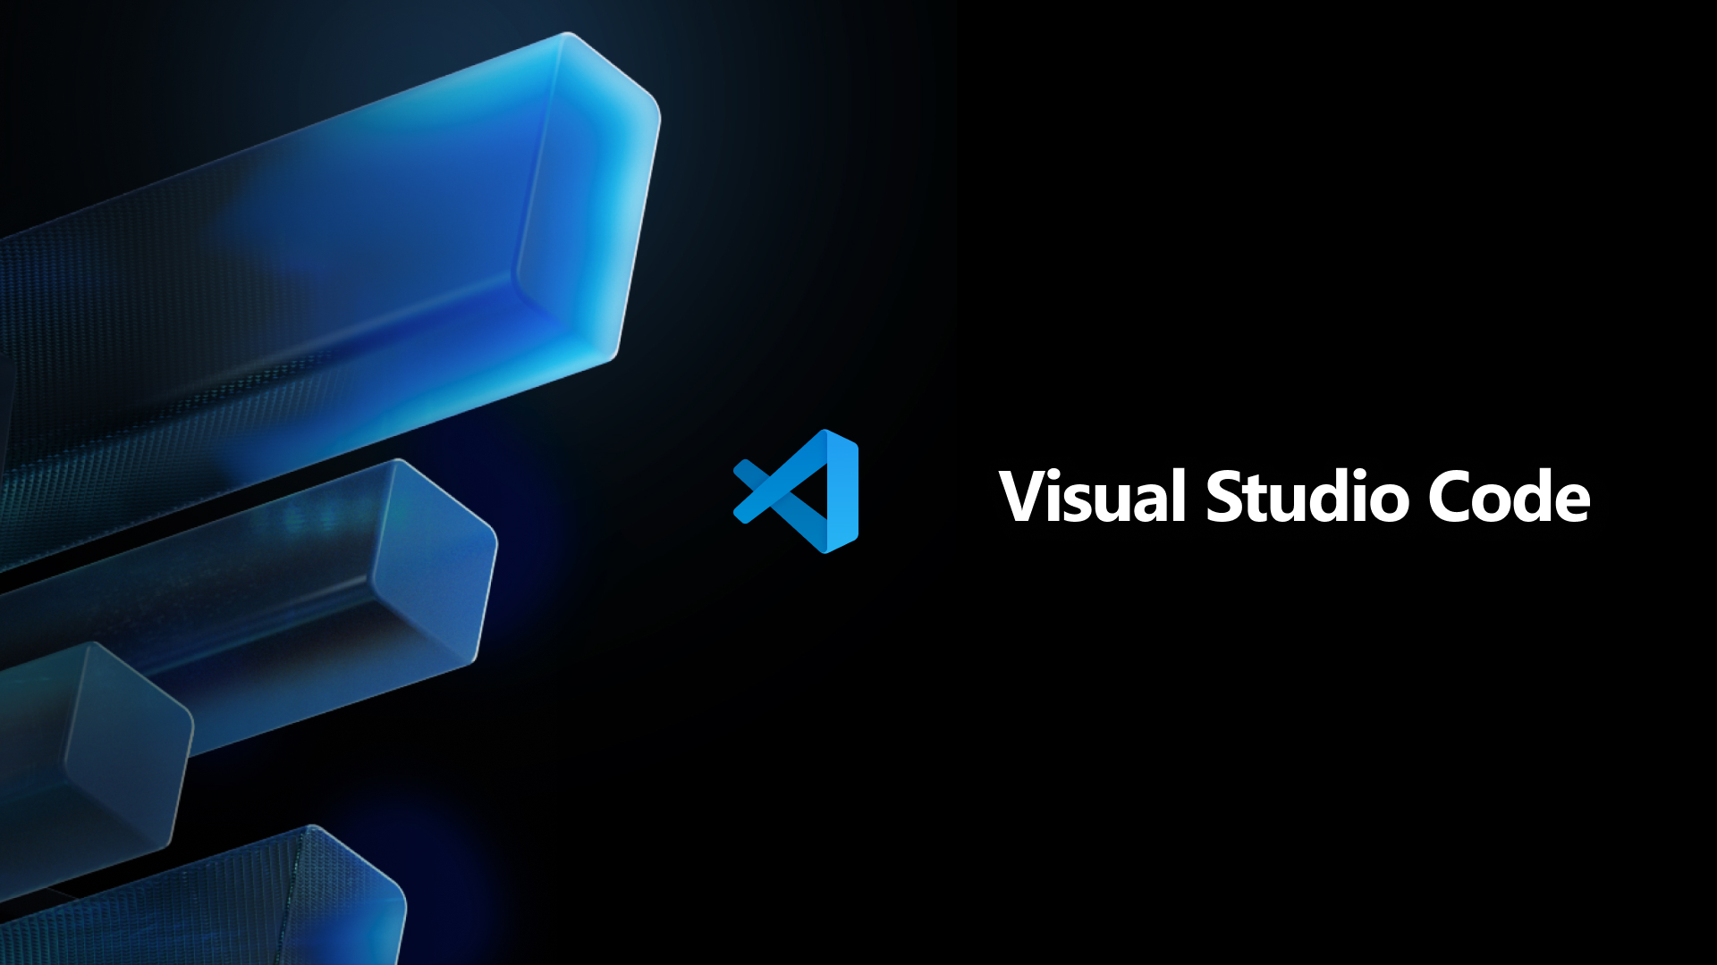
TUTORIAL

Slide 6
How to download and install visual studio code
https://youtu.be/oJG3CMLeD4U
Go to code.visualstudio.com.
Select the Download for Windows blue button.
Run the install executable, by first accepting the software agreement.
Click next two times in a row, and then click install.
For Python:
Go to python.org/downloads
Download Python for Windows.
Run the install executable.
When it is completed, open windows cmd prompt, and type py --version. A version level should be returned if install was a success.

Slide 7
How to use python within visual studio code
https://youtu.be/XsIs3S-ooyI
In VS Code, navigate to Extensions icon (a set of four squares) on left side panel.
Type code runner in the Extensions search box, and install the top .run code runner extension.
Next, type python in the Extensions search box, and install the top python for windows extension.
Creating a Python Project:
Close the Extensions pop up box, and click the Folders icon (a set of 2 folders) at top of left side panel.
In the popup window, select the new folder icon and create a folder named Python Projects.
In the top of the Explorer pane, select the new file icon and create new file test.py.
Type inside the test.py file, print("Hello World").
Clicking on the pull down arrow located to the right of the run/play icon near the upper righthand section of the VS Code application., select Run Python File.
In the bottom panel of the VS Code application is the Terminal screen. The output text Hello World should be displayed within the Terminal screen.
Alternately, typing py test.py or python test.py (if an environment variable py pointing to executable location of python.exe), will also return output text Hello World.

Slide 8
HOW TO DOWNLOAD/INSTALL GIT, INITIALIZE REPOSITORY, COMMIT, PUSH
https://youtu.be/4DfUrQ29nzw
Go to git-scm.com/downloads. Select Windows from Downloads section, and then click the Click Here to DownLoads link.
For Mac users, install Git via Homebrew or MacPorts, or download Xcode from the App Store.
Double-click the downloaded executable to install.
During the install, you can choose whichever settings you want, but I recommend keeping all of the default settings, except for the following:
For the Adjusting the name of the initial branch in new repositories section, choose Override the default branch name for new repositories, make sure that main is typed in the textbox.
For the Configuring the line ending conversions section, choose Change to checkout as-is, commit Unix-style line endings.
For the Configuring extra options section, uncheck both check boxes.
To make sure GIT is successfully installed, open the windows command prompt and type git –-version . If successful, the version will be displayed. (Make sure to close and reopen the command prompt window first if it were already opened).
Launch VS Code.
Click the profile icon near the very bottom of the left side panel (it looks like a head). Select Backup and Sync Settings from the menu. Then select Sign in with GitHub from the following menu and sign into github.
If the step above does not work, do this: Type into command prompt: git config --global user.name "yourname" or git config --global user.email "your email address"
(Note: The following instructions are just informational and should be used to familiarize yourself with git).
Open the folder that was created in the step above, for Python Projects.
In left side panel, select the Source Control icon (shaped like a Y with small circles on its end points). This is where you would also push and pull.
Click the Initialize Repository button. And then click the Add Folders icon to add a folder.
Click the Source Control icon again and enter message into the textbox above the commit button. Then press the Commit button. Next, press Publish to Branch button and select Publish to Public Repository. If you log into Github, you will find your repository.

Slide 9
HOW TO CLONE GIT REPOSITORY AND MAKE NEW BRANCH
https://youtu.be/r4H0r68fr3k
Launch VSCode.
Select the Welcome Tab and click the Clone Git Repository link from the list located under the Start heading. Alternatively, you click inside he Search bar at the top of the VSCode page and select Show and Run Commands from the dropdown list, and then type Git Clone into the Search bar. Paste the url of the repository you wish to clone, in this case for our pod, it would be https://github.com/kingomes/ide-project . Then press Enter and choose a folder location for saving the cloned repository.
To work within your own branch, select the main link located at the bottom left corner of the VS Code page. Select Create New Branch, enter a name for the branch at the bottom left corner of VS Code page, in place of main. This Branch is created in order to not break anything in the main branch.
Edit the ide.py file. Then click the Source Control icon, and select the plus sign icon found at the right of the Changes heading, found underneath the Commit button. Select Staged Changes to view the changes, and then after adding documentation within the Source Control section's text boxes, press the Commit button, and then click Publish it to Branch.
If you get the message "You don't have permission to push to Kingomes/ide-project. Would you like to create a fork and push to it instead?" , then make sure that the owner of the repository grants you access to the repository.
A Pull request will enable your changes to be merged with the main branch. It can be initiated from either the Github website, or VS Code.
Pulling in VS Code: Click the extensions icon, and type into the search bar Pull request. Select the Git Pull request extension with the cat silhouette symbol to the left.
Click on the Pull request icon (cat silhouette) . Then to the right of the Pull Requests heading, select the plus sign looking icon in order to create a pull request. Type in description documentation into the text boxes and then the click "Create" drop down box and select Create from the other secondary drop down box. The repository owner will have to approve the merge.
Within the main panel in VS Code, information on the Pull Request will be returned. Look to make sure that your Pull Request did not generate any conflicts.

Slide 10
HOW TO REVIEW AND MERGE PULL REQUESTS
https://youtu.be/zB4WZbiCyy8
If the Pull Request extension is not already installed: Click the extensions icon, and type into the search bar Pull request. Install the Git Pull request extension with the cat silhouette symbol to the left.​
Click the Pull Request icon. A message might pop up asking for a folder to be opened. Navigate to your local folder that holds the local GitHub repository. Then click the Pull Request icon once more.
Under Solution Explorer on lefthand side, navigate to All Open [pull requests] and look for one of the pulled request listed under that heading.. Clicking on one of the pulled request filenames listed under that heading will show the differences in the code that is to be merged.
Clicking on the Description link above the listed filename will display a github type pull request page. This Pull Request tab will indicate if there are any conflicts that exist between the two files. If there are no conflicts, simply select buttons to Approve and Merge pull request. If any conflicts occur, one option would be to open GitHub.
Once in the GitHub folder, manually resolve the conflicts first that may exist between the two versions, and then Approve and Merge.

Slide 11
HOW TO LIVE SHARE ON VISUAL STUDIO CODE
https://youtu.be/-fyCdQ4h1sY
Launch VS Code.
Click the Extensions Click the extensions icon, and type into the search bar Live Share and install it.
Open your test.py file.
Click the Live Share link at the bottom left side border (to the right of the main link) of the VS Code page. On left side panel there is also a Live Share icon (a right curved arrow on top of a small circle). After that is clicked, the Live Share invitation link is copied to the clip board for you to send to your collaborator(s).
Once the collaborator opens the link, the browser will ask for permission for the collaborator to open VS Code, and for the Live Share extension to be used. Once granted, VS Code is opened, with the file the original user Live Shared opened as well.
The collaborator can then type freely in the file.
After the test.py is run with code runner by the Sharer, the output of the run will be able to be viewed by the Collaborator
If the Collaborator wants to be able to run the file, he or she won't be able to use the code runner extension to run the file. He or she will want to attempt to type into the terminal section at the bottom frame of Visual Code, triggering VS Code to ask the Collaborator to ask for Read/Write to access the terminal. After the Sharer grants the permission, the Collaborator can run the code through the terminal.

Slide 12
HOW TO USE GITLENS IN VISUAL STUDIO CODE
https://youtu.be/BGQCx7w8I-U
Code Blame and Insights
Displays detailed commit information directly in the editor, showing who made changes to the code, when, and why, making it easier to understand the code’s history.
Visualize Repository and Branch History
Offers a graphical view of your Git repository, allowing you to navigate through commits, branches, and tags visually.
Enhanced Code Navigation
Allows you to quickly navigate through a file’s revision history, view side-by-side comparisons, and track the evolution of a file or code block.

Slide 13
Some other cool extensions/ FEATURES

Slide 14
Github co-pilot
Accelerates Coding Productivity: GitHub Copilot provides AI-powered code suggestions and autocompletion, reducing time spent writing boilerplate code and helping developers work more efficiently.
Context-Aware Assistance: It understands the context of the project, offering intelligent code suggestions, which can speed up debugging and implementing complex algorithms.
Learning Tool: For developers, especially those still learning or working with new languages, Copilot serves as a helpful guide by suggesting best practices and writing clean code.

Slide 15
Turbo Console log
Enhanced Logging: Simplifies the process of adding, managing, and formatting console logs in code, making debugging faster and more efficient.
Customizable Log Templates: Provides pre-configured log templates for quick insertion, ensuring consistent log format throughout the project.
Productivity Boost: Reduces manual effort in writing repetitive logs, allowing developers to focus more on coding and troubleshooting.

Slide 16
CODE SPELL CHECKER
Error Prevention: Detects and highlights spelling mistakes in code comments, strings, and documentation, helping to maintain code clarity and professionalism.
Supports Multiple Languages: Works with various programming languages and dictionaries, ensuring accurate spelling across diverse coding projects.

Slide 17
Multi line editing in visual studio code
https://www.youtube.com/watch?v=ESlgCx_KQG8&ab_channel=LeilaLewis
Multi-cursor Editing: Multi-line editing in Visual Studio Code allows users to place multiple cursors in different parts of a file to edit or insert text simultaneously across multiple lines.
Shortcut Activation: This feature can be activated by pressing Alt (Windows/Linux) or Option (Mac) and clicking in multiple locations, or using Ctrl + Alt + Arrow keys to select and edit consecutive lines vertically.
Efficiency in Bulk Changes: It speeds up repetitive changes, such as adding or modifying identical code snippets, making bulk edits more efficient and reducing the time needed for tasks like renaming variables across a file.

Slide 18
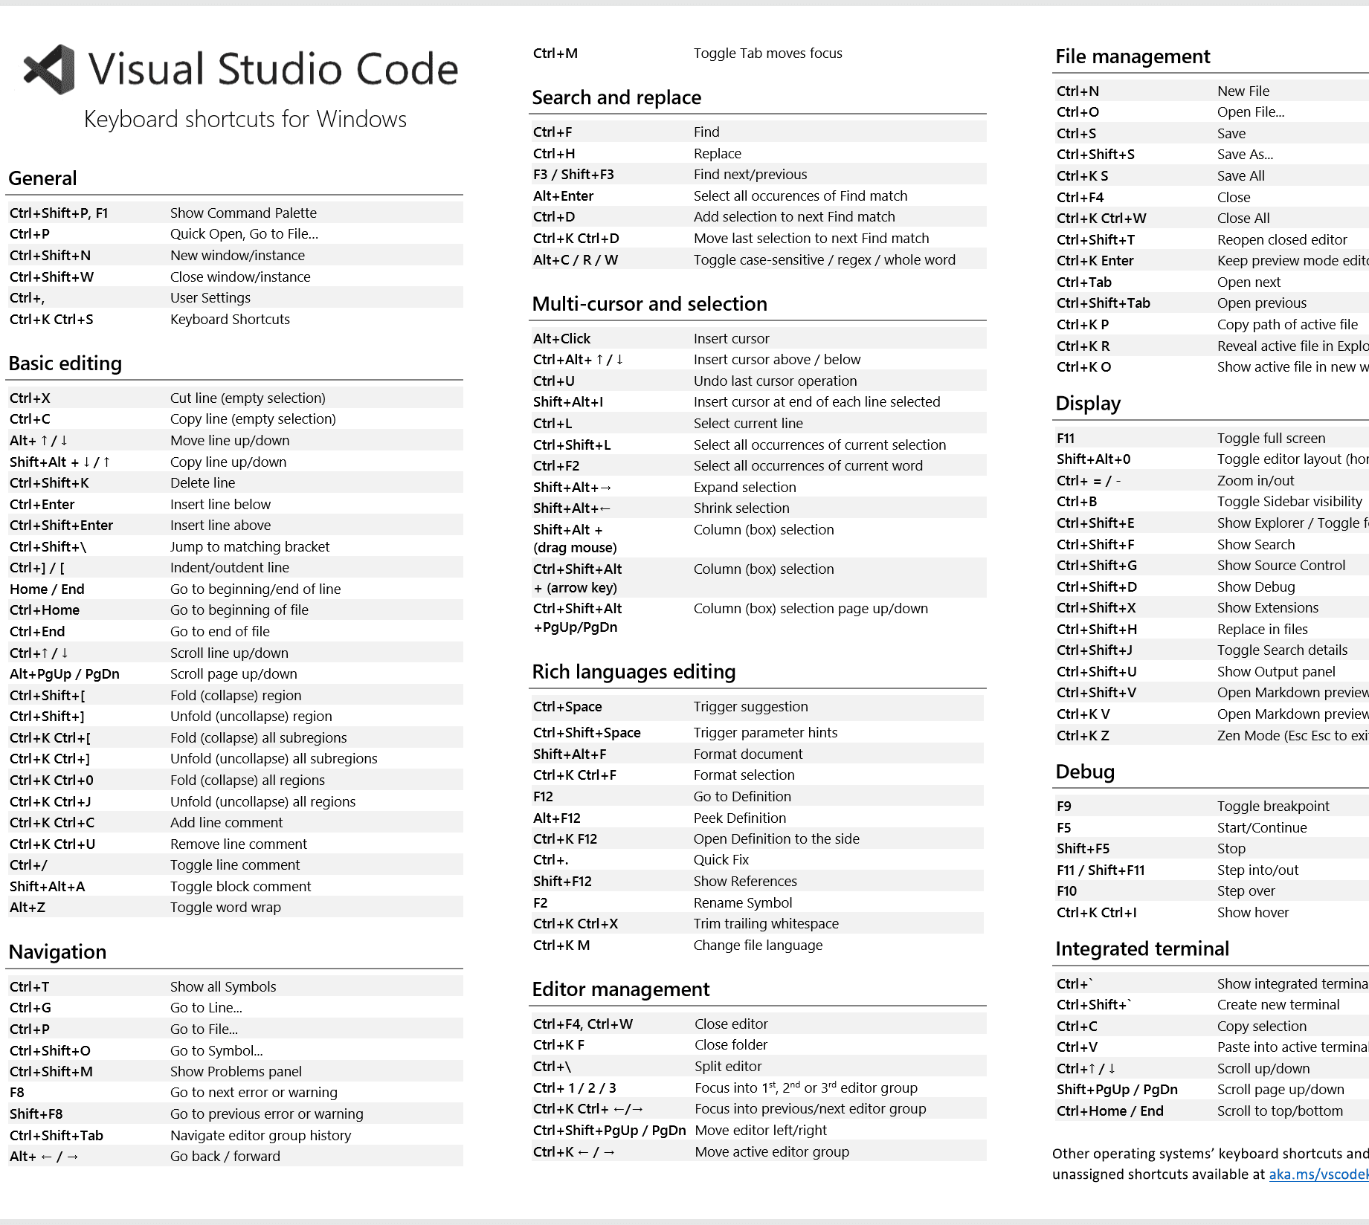
Visual STUDIO CODE KEYBOARD SHORTCUTS
Ctrl + P (or Cmd + P on Mac)
Quick Open File: Quickly opens files by typing part of the filename.
Ctrl + Shift + P (or Cmd + Shift + P on Mac)
Command Palette: Opens the command palette where you can execute any command without needing to memorize the shortcuts.
Ctrl + / (or Cmd + / on Mac)
Toggle Line Comment: Comments or uncomments the current line or selected block of code.
Ctrl + B (or Cmd + B on Mac)
Toggle Sidebar Visibility: Opens or closes the sidebar (file explorer, source control, etc.).
Ctrl + D (or Cmd + D on Mac)
Select Next Occurrence: Selects the next occurrence of the word under the cursor for multi-editing.

Slide 19
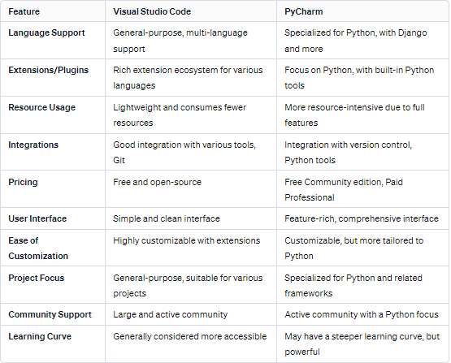
Why use vs code over pycharm or any other ide?
Ok so you are probably thinking why not just use an IDE specifically made for Python such as PyCharm if we exclusively used Python in our examples or why not use any other IDE in general. What makes VS code so special and why did we choose this as our IDE to do the workshop on?
PyCharm would be better suited for someone who develops exclusively with Python. However, as software engineers you should be flexible with the coding languages you use and that is why Visual Studio Code is the most widely used IDE among professional and casual developers. Python is just the language we chose to do the tutorials with to make everything consistent. But in the industry, you will be using multiple languages.
Lightweight and Fast: VS Code is lightweight, fast, and uses fewer resources compared to heavier IDEs like PyCharm, making it ideal for large projects and responsive performance.
Customization and Extensibility: VS Code has a vast marketplace of extensions for languages, frameworks, and tools, allowing for extensive customization, including themes and keyboard shortcuts. PyCharm is more limited in this area.
Cross-Platform Compatibility: VS Code works seamlessly across Windows, macOS, and Linux, offering a consistent experience on all operating systems.
Integrated Git Support: Built-in Git tools make version control straightforward in VS Code, enabling you to manage repositories, commits, and conflicts directly in the editor. PyCharm's Git features can feel more cumbersome.
Active Development and Community: VS Code benefits from frequent updates and a large, active community that offers resources, tutorials, and extensions.
Integrated Terminal: The built-in terminal in VS Code allows you to run commands without leaving the editor, streamlining workflows. This feature is more smoothly integrated compared to PyCharm.
Wide Language Support: VS Code supports many programming languages out of the box, while PyCharm is focused more on Python. VS Code is better suited for multi-language projects.
IntelliSense and Code Navigation: With smart code completion (IntelliSense), go-to-definition, and symbol search, VS Code excels at code navigation, making it easier to work with large codebases.
Debugging Tools: VS Code includes powerful debugging tools for multiple languages, offering breakpoints, variable inspection, and step-through functionality within the editor.
Free and Open Source: VS Code is free and open-source, with no licensing fees. PyCharm has a paid Professional version, while the Community version offers limited features.

Slide 20

SOURCES
https://x-team.com/blog/best-vscode-extensions
https://blog.logrocket.com/pycharm-vs-vscode/
https://code.visualstudio.com/docs/editor/whyvscode
https://www.codecademy.com/article/what-is-an-ide
https://aws.amazon.com/what-is/ide/
https://code.visualstudio.com/docs/editor/extension-marketplace
https://www.freecodecamp.org/news/best-vscode-extensions/
https://code.visualstudio.com/
https://code.visualstudio.com/docs/sourcecontrol/overview
https://code.visualstudio.com/docs/sourcecontrol/intro-to-git
https://www.digitalocean.com/community/tutorials/how-to-use-live-share-with-visual-studio-code

Slide 21

QUIZ TIME Go to kahoot.it

